Slide 1



Supervisor
Dr. Yasir Saleem
Co-Supervisor
Engr. Afeef Obaid
GlucoSense: Smart Non-Invasive Glucose Monitoring System
Student # 1 | Student # 2 | Student # 3 | Student # 4
2021-CE-23 | 2021-CE-18 | 2021-CE-13 | 2021-CE-15
Dr. Yasir Saleem

Slide 2

Contents
Introduction
Problems Identified
Solutions Explained
Shortlisted Solutions
Implementation Details
Experiments and Results
Validation Mechanism
Test Cases
Analysis of Results
Future Direction and HOTO
Status of the Artifact
Dr. Yasir Saleem

Slide 3
Introduction
A non-invasive glucose monitoring system designed to eliminate painful finger-pricking.
Uses infrared (IR) sensor, increasing its amplification through amplification circuit, to measure glucose levels through the skin, offering a comfortable alternative.
Traditional glucometers are invasive, while existing non-invasive solutions often suffer from limited accuracy.
This project aims to enhance accuracy using improved circuit design, skin thickness analysis, and machine learning for more reliable results.
Dr. Yasir Saleem

Slide 4
Problems Identified
Painful and Invasive Nature of Traditional Glucose Monitoring Methods.
Lack of Real-Time Monitoring and Accuracy in Existing Medical Devices.
High Cost and Limited Accessibility of Current Glucose Testing Solutions.
Poor User Experience and Lack of Smart Features in Traditional Devices.
Technical Barriers in Developing Reliable Non-Invasive Glucose Monitoring Systems.
Dr. Yasir Saleem

Slide 5
Solutions Explained
Replacing Painful Finger-Prick Method with Infrared-Based Non-Invasive Sensing.
Enhancing Signal Quality Through Amplification and Filtering Circuits.
Addressing Individual Differences with Finger Thickness Measurement.
Accurate Glucose Prediction Using Arduino and Machine Learning Integration.
Providing Real-Time, Historical, and Trend-Based Data via Mobile Application.
Dr. Yasir Saleem

Slide 6
Shortlisted Solutions
Adoption of Infrared (IR) Sensors for Painless Glucose Detection.
Implementation of Signal Amplification and Low-Pass Filtering Circuit.
Integration of Ultrasonic Sensor for Personalization Based on Finger Thickness.
Utilization of Arduino Nano for Signal Digitization and On-Device Processing.
Development of a Mobile Application for Live Monitoring and User Engagement.
Dr. Yasir Saleem

Slide 7
Implementation
Hardware setup:
IR sender and receiver are placed to detect IR absorption through skin thickness.
Amplification circuit built to enhance the weak sensor signals.
Arduino Nano programmed to capture amplified signals and send them for prediction.
Software setup:
Neural Network trained on collected sensor data for glucose prediction.
Mobile application developed to display the real-time glucose readings.
Dr. Yasir Saleem

Slide 8
Experiment and Results
Data Collection:
Collected paired data: IR sensor voltage readings and actual invasive glucose values (via glucometer).
Included diverse samples: age, weight, thickness, and dia/non-dia individuals.
Model Training & Accuracy Achieved:
Trained a regression-based Neural Network using 80% of data; 20% used for testing.
Model achieved 80% accuracy in predicting glucose values within an acceptable error margin.
Dr. Yasir Saleem

Slide 9
Experiment and Results Cont’d
System Testing:
Tested on 100+ individuals with varying glucose levels.
Predictions closely aligned with actual values recorded by glucometer.
Dr. Yasir Saleem

Slide 10
Validation Mechanism
Comparison with Traditional Finger-Prick Glucometer Readings.
Multiple Trials Conducted on Different Individuals.
Use of Statistical Tools to Analyze Prediction Accuracy.
Machine Learning Model Evaluation through Performance Metrics.
Use of a Dark Black Enclosure to Minimize Light Interference.
Dr. Yasir Saleem

Slide 11
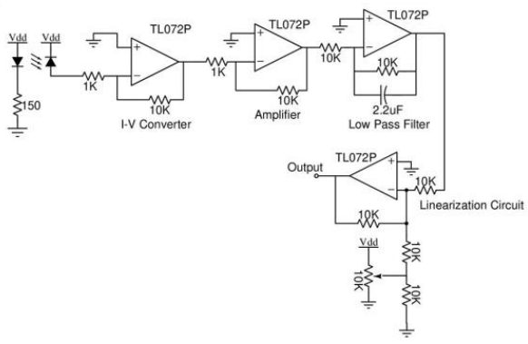
Implementation
Amplifier circuit
Dr. Yasir Saleem

Slide 12
Test Cases & Validation
User Registration & Login:
Checks secure access flow using valid/invalid email, password, age, and gender inputs.
Pass if success message is shown after valid input, and error message appears for invalid or duplicate entries.
Hardware Validation:
Verifies stable data from IR and ultrasonic sensors when the finger is placed properly.
Pass if real-time values are correctly displayed and transmitted to the app without noise.
Dr. Yasir Saleem

Slide 13
Test Cases & Validation Cont'd
Glucose Prediction Accuracy:
Tests the neural network model with varied glucose patterns (low/normal/high).
Pass if predictions match expected glucose range with correct condition label (hypo, normal, hyper).
Data Logging & Report Generation:
Ensures glucose values with context are saved in the PHPMyAdmin database.
Pass if values are stored with timestamp and visible in user history and charts.
Dr. Yasir Saleem

Slide 14
Analysis of Results
The GlucoSense system successfully predicted blood glucose levels using a non-invasive IR sensor setup, paired with an amplifier and low-pass filter circuit for signal conditioning.
The neural network model gave accurate glucose predictions after analyzing real-time sensor data from the user’s finger.
Results showed a strong correlation with expected glucose trends in users (e.g., fasting or post-meal states), validating the model’s predictive accuracy.
The system generated a glucose report on the connected PC, which can be accessed through the administrator for record review and tracking.
Tests on different users showed that the system gave consistent results, supporting its potential use for easy daily monitoring.
Dr. Yasir Saleem

Slide 15
Future Enhancements
Integration of a camera module to capture multifactorial skin parameters (color, texture).
Improved machine learning model accuracy using more training data.
Cloud-based storage of patient reports for remote access.
Real-time doctor integration and remote monitoring.
Addition of a health dashboard in the app with alerts and lifestyle tips.
Dr. Yasir Saleem

Slide 16
Handover/Takeover (HOTO)
Complete documentation has been prepared:
Arduino & mobile app source code
Trained neural network model
Circuit diagrams & component list
Flowcharts, use cases & test data
Project is ready to be handed over to the department for future research or enhancement.
Dr. Yasir Saleem

Slide 17
Status of the Artifact
Functional Status | Operational Status
IR sensor and receiver successfully read signals Amplifier circuit boosts weak signals accurately Preprocessing is done before ML prediction Neural Network predicts glucose level correctly Patient report is generated and displayed in the app | Complete prototype is working and tested Real-time data is processed and output shown System performs well in dark light User can interact easily and view final glucose report Device is ready for demo and presentation
Dr. Yasir Saleem

Slide 18


